Slide 1
Lab Streaming Layer
Kieran Nichols

Slide 2
Overview
Introduction
Flowchart
fNIRS
Xsens
Other Devices
Data Recording
How to use
References

Slide 3
Lab Stream Layer: Introduction
Open-source middleware to stream synchronized data that can be used for our data collection needs (Kothe 2014, Wang et al. Virtual Reality, 2023)
Allows for central program to collect data from multiple devices to single file
Has previous been used by Aakash to collect fNIRS data

Slide 4
NASA Lab Stream Layer: Streaming data
Possible to integrate, but difficult and time-consuming
fNIRS
Xsens
EMG
Tobii
Force Plate
Emaptica
Xsens
EMG
Tobii
Force Plate
Emaptica
LSL
Lab Recorder
Timestamps
Video
Data Visualization
Recorded Data File
Notes:
Green represents the extra programs to run the LSL communication between the device program and the LabRecorder
Add data visualization module and lsl module

Slide 5
NASA LSL Data post-processing
Xsens, EMG, Tobii, Timestamps, and Video-camera do not need post-processing to view the data
We have a solution to deal with the Xsens ref frame issue
fNIRS have been most trouble-some in post processing
We could not find other open-source code and Jeevan is still waiting for permission to join the Homer3 group
To convert the fNIRS LSL data, I created code to convert it into Homer3 compatible data (t, s, SD, d, aux)
t: time (from LSL)
s: stimulation (we do not use this variable)
SD: source/detector info (from native file). It will be consistent for all of our data collections.
d: data points for the source/detector voltages
aux: accel and gyro data

Slide 6
Lab Stream Layer: fNIRS
Aurora has in-built code for LSL
To stream the data, we just need to record in Aurora
Xu et al., Frontiers in Neuroscience, 2024
Validating the reproducibility of a low-cost single-channel fNIRS device across hierarchical cognitive tasks
Did finger-tapping and n-back tasks
Used LSL to record and synchronize their event markers and fNIRS data
Notes:
Add picture of Aurora GUI
Xu, Shiyang, et al. "Validating the reproducibility of a low-cost single-channel fNIRS device across hierarchical cognitive tasks." Frontiers in Neuroscience 18 (2024): 1351341.

Slide 7
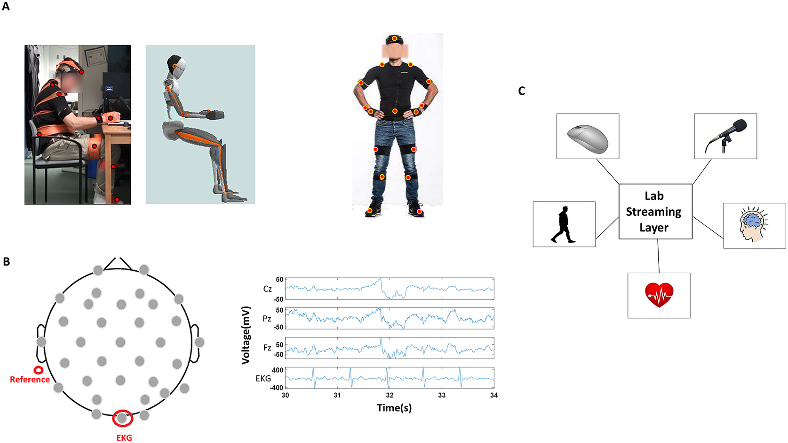
Lab Stream Layer: Xsens
There was previous base level of C++ code
I had to rebuild it for the Windows System
We can choose which metrics to stream
LSL program will give us information about the health of the streaming code
We don’t need to record data in the Xsens GUI; it automatically streams to LSL program
Ryu and Torres, Wearable Tech., 2022
Toward interpretable digital biomarkers of walking and reaching in Parkinson’s disease
Notes:
Add picture of Xsens GUI
Add picture of metrics
Ryu, Jihye, and Elizabeth Torres. "Toward interpretable digital biomarkers of walking and reaching in Parkinson’s disease." Wearable Technologies 3 (2022): e21.

Slide 8
Lab Stream Layer: Other devices
Force plate, EMG, Empatica
It will take more work to build LSL code for these devices as they are less supported
Should I focus my some of my time on the Force plate or EMG?
Data from the Force Plate and Empatica do not need to be synchronized

Slide 9
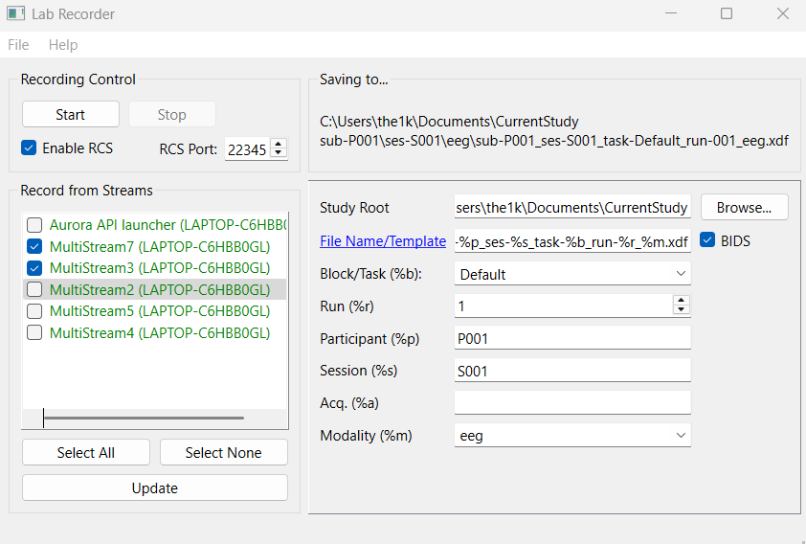
Lab Stream Layer: Data Recording

Slide 10
How to use (Training folder on Lab’s Onedrive)
Open devices’ software
Open LabRecorder.exe in LSL/LabRecorder (allow it through your firewall on private and public networks)
Run LSL programs for devices
fNIRS (in Aurora)
Xsens executable: LSL/Xsens-windows/streaming_protocol.exe
Tobii executable: LSL/Tobii_glasses/LSL_code/G3LSLConnector.exe
EMG Matlab code: LSL/EMG and Other Matlab/liblsl-Matlab/EMG_streaming.m
Timestamps Python code: LSL/Timestamps/Timestamps.py
Video_record Python code: LSL/LSL_video_capture.py

Slide 11
How to use
You can get software for other devices here: Supported Devices and Tools — Labstreaminglayer 1.13 documentation
Click “Update” on LabRecorder to view all available LSL streams
Click “Start” and “Stop” to start and stop collecting data

Slide 12
How to use
Continuation
If you want to stream fake data to test the LSL, you can run SendMultipleStreams.exe in LSL/LSL_examples
To view the data, use “load_xdf(“filename”) in MATLAB
Ensure that the search path in MATLAB is looking for “LSL/xdf-Matlab-master/xdf-Matlab-master”
You can view the data as a series of structures

Slide 13
Lab Stream Layer: Data Analyzing
Recorded Data file can easily be read in Matlab or Python
It contains data structures with device information, metrics and their data, and timestamps (Kothe et al., bioRxiv, 2024)
In Matlab, we can quickly and easily check the data
Use the load_xdf(‘filepath’) function
Notes:
Kothe, Christian, et al. "The Lab Streaming Layer for Synchronized Multimodal Recording." bioRxiv (2024): 2024-02.

Slide 14
full-NASA Native files
We will also save the native files for each battery of sensorimotor tasks.
We have the space and computational power.
It will be unsynchronized but can be an extra source of data as the native files contains more metrics than the real-time streamed data, especially Xsens and Tobii.
We can use AutoHotKey to get the start of each data file within 0.3 sec
Notes:
Use electronic notebook to get timestamps and start and end

Slide 15
full-NASA LSL Limitations
Does not have as much data as the native data files.
It does not contain video or animated data (Tobii, Xsens, Video camera).
fNIRS: the accel and gyro data may be resampled differently to our resampling
Xsens: we do not get joint data, heel/toe contact
Tobii: we do not get Gaze xy
Force plate: not integrated
EMG: there may be a few frames per second that are repeated (3/2000 frames)
Overall, the LSL is reliable. Most of our issues came from individual device software.

Slide 16
Extra

